Slide 1
Surgical Neurology International • 2022 • 13(555) | 1is is an open-access article distributed under the terms of the Creative Commons Attribution-Non Commercial-Share Alike 4.0 License, which allows others to remix, transform, and build upon the work non-commercially, as long as the author is credited and the new creations are licensed under the identical terms.
©2022 Published by Scientific Scholar on behalf of Surgical Neurology International

Slide 2
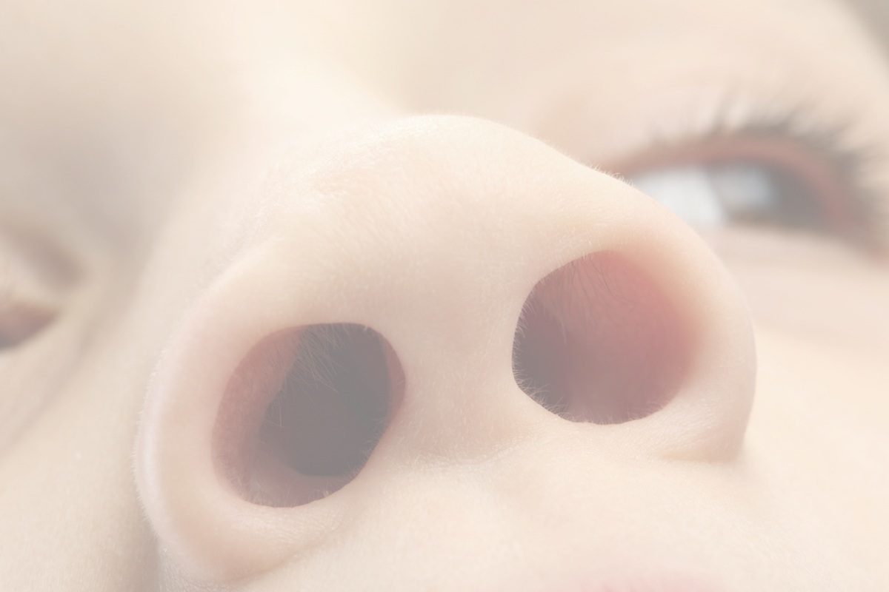
Rifle cleaning rod through the nose.

Slide 3
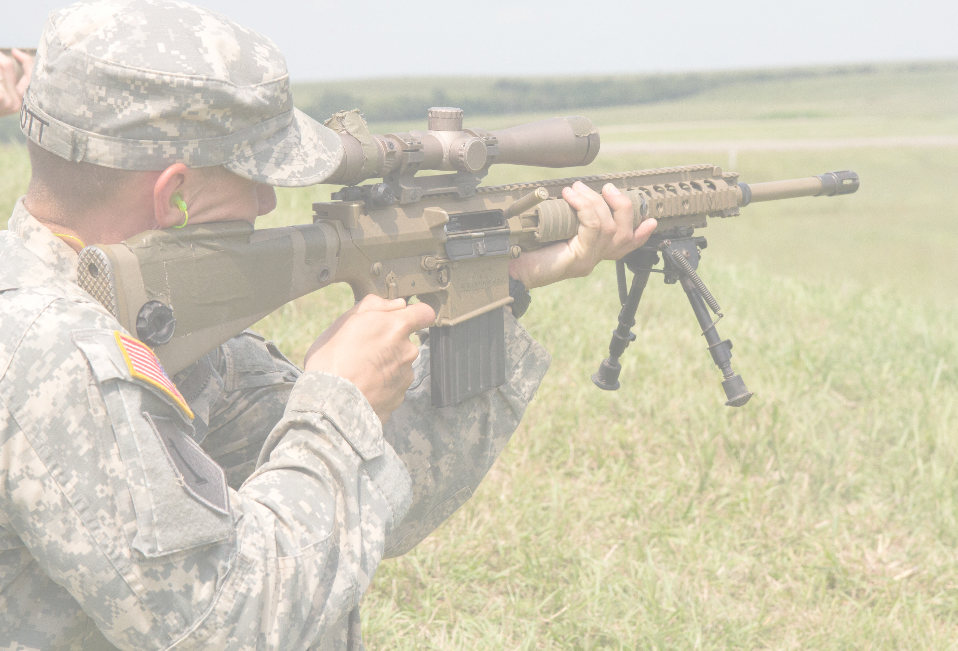
Patient accidentally shot himself in the face with a rifle cleaning rod.

Slide 4
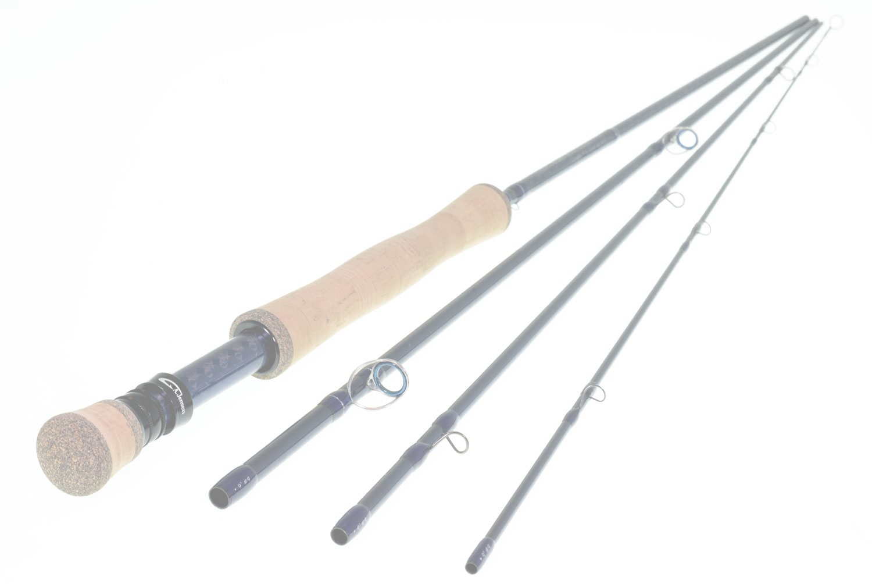
A patient with a rifle cleaning rod in his brain was successfully treated by a multidisciplinary team.

Slide 5
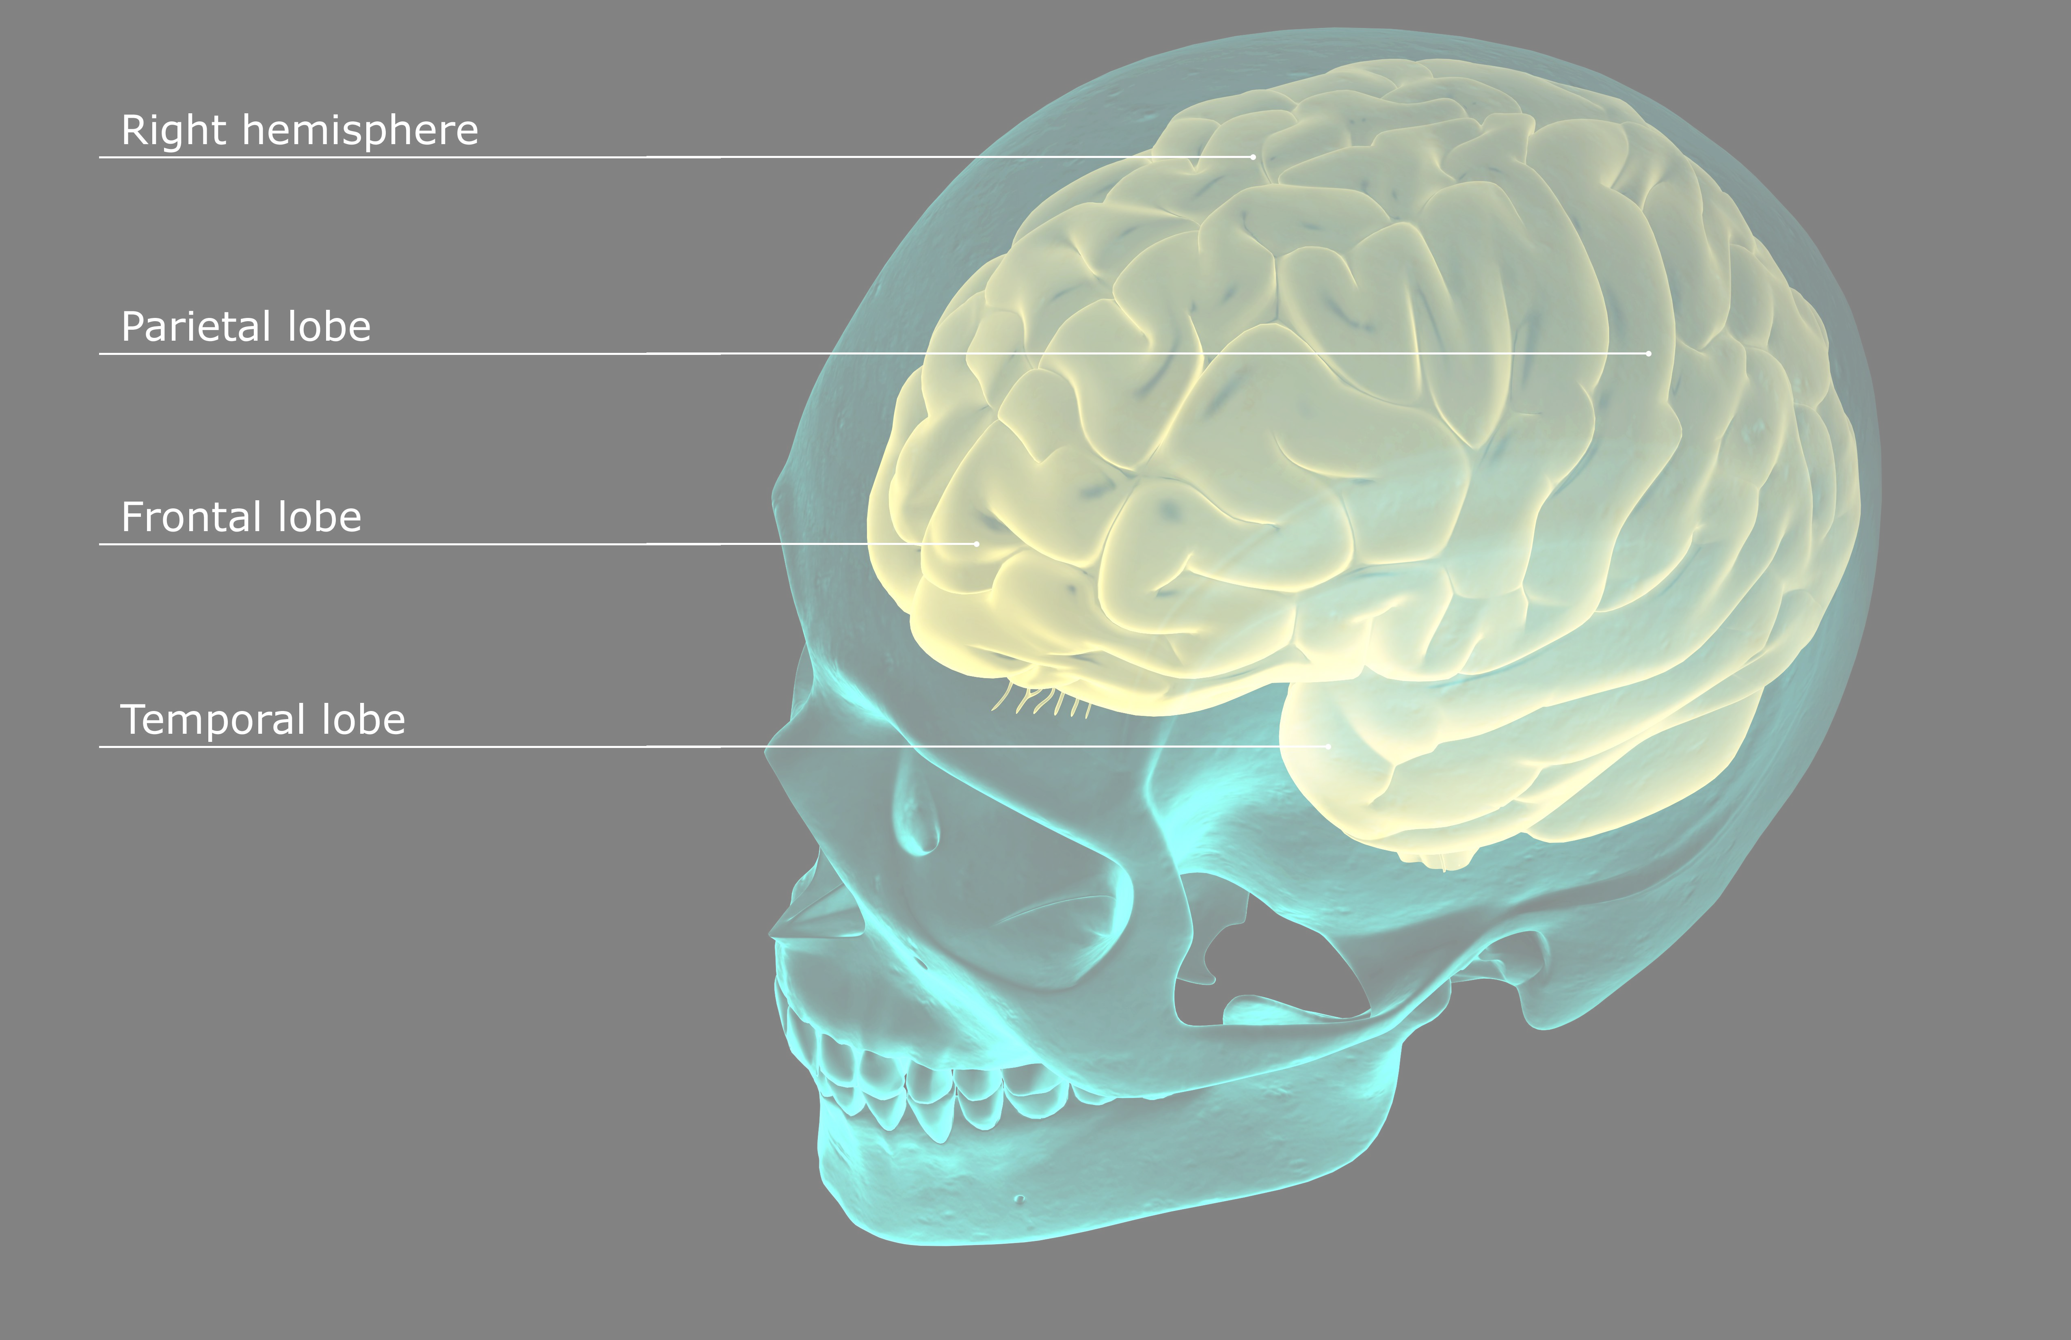
e bullet entered the skull at the right orbit, passed through the right temporal lobe, and lodged in the right

